Slide 1

Year 5 Residential
9-10th July 2026

Slide 2
Questions
Please hold questions for now - there will be the opportunity to ask questions at the end of the session

Slide 3
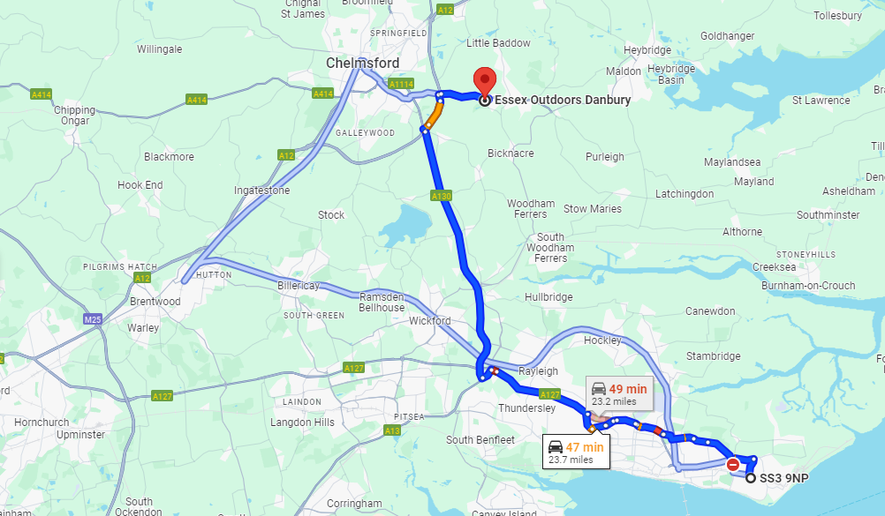
Location
Essex Outdoors Danbury
A purpose-built site, set in over seventy acres of stunning woodland area in the heart of the county near Chelmsford.
It should take roughly 1hour to get there. We will be travelling via minibuses

Slide 4
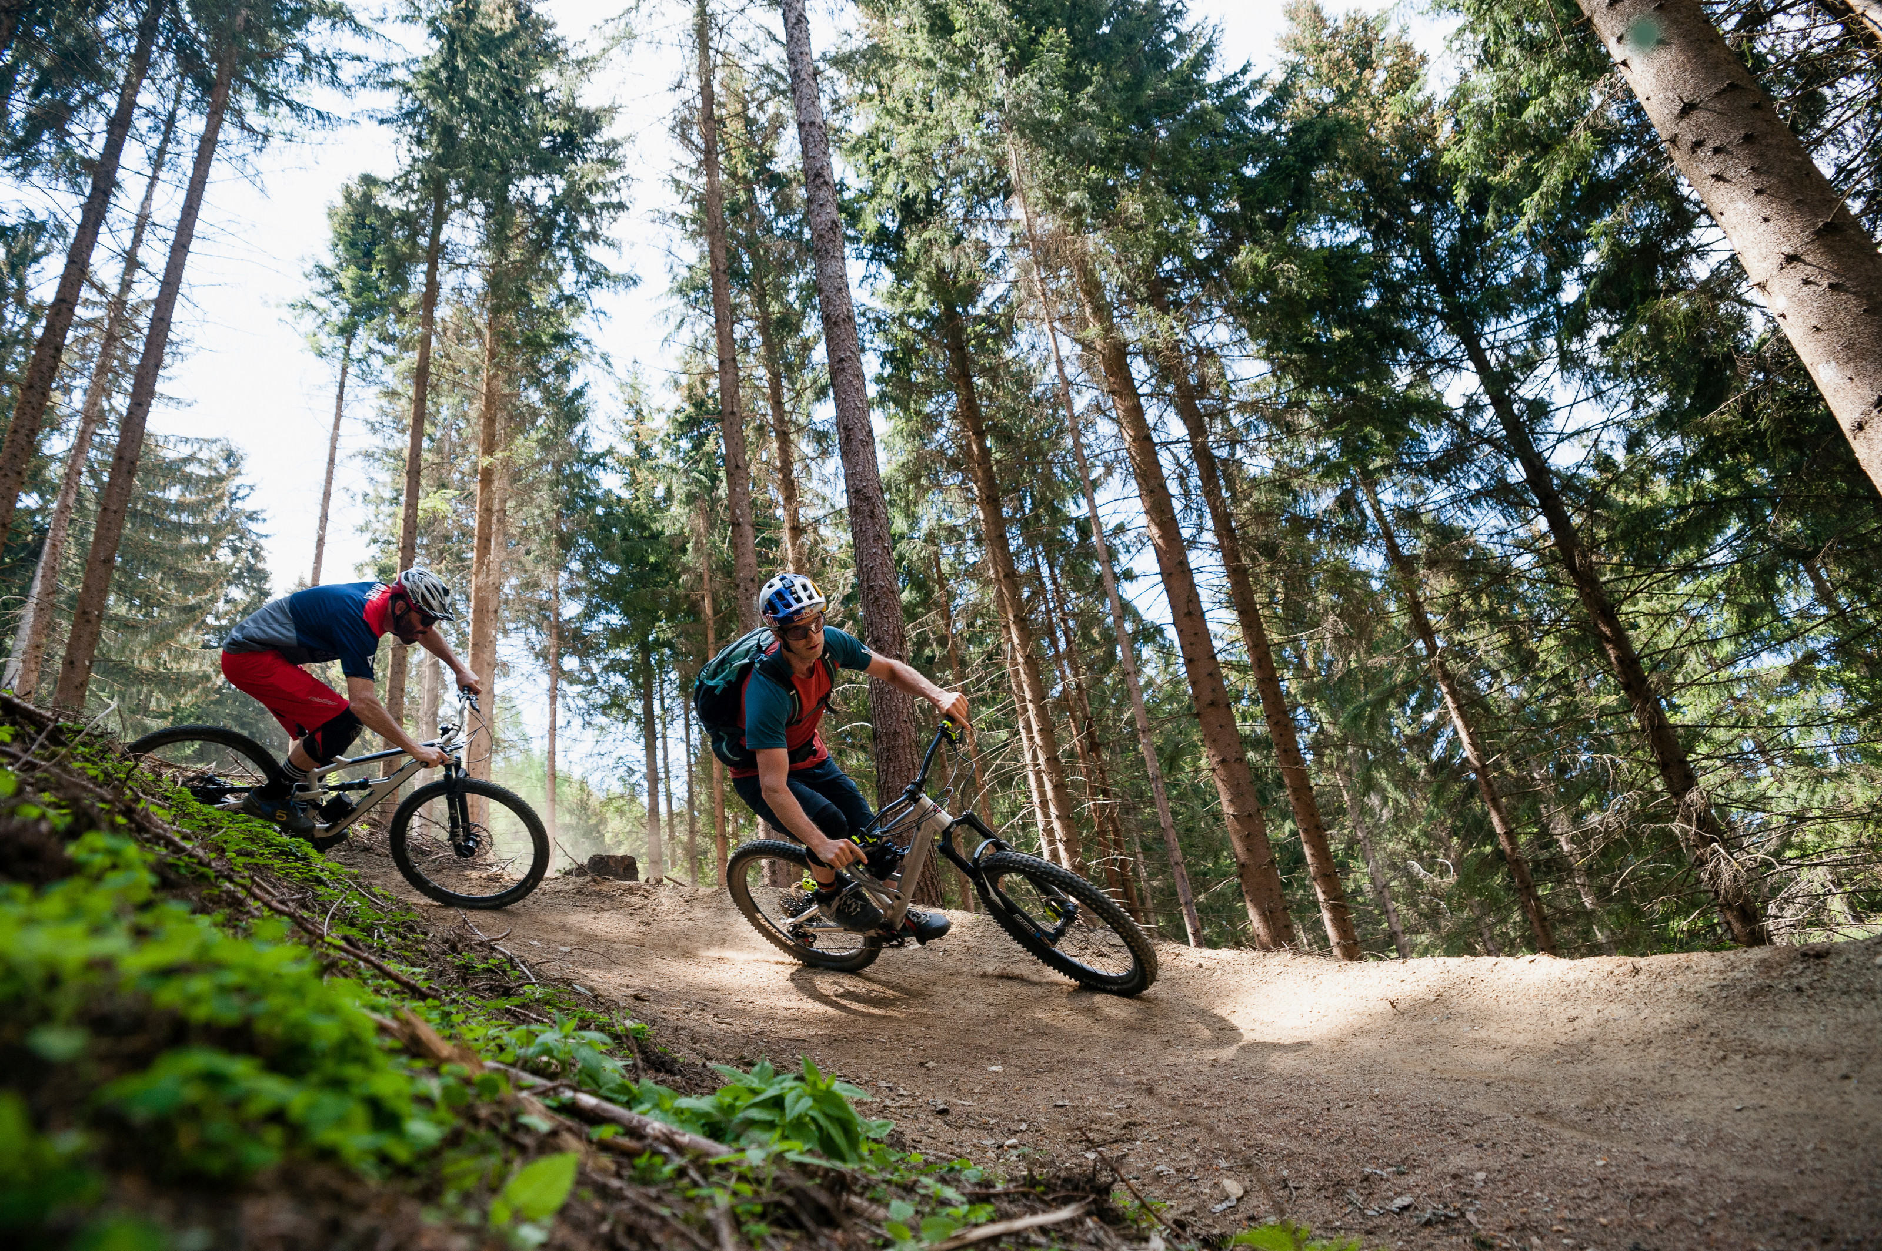
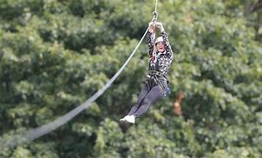
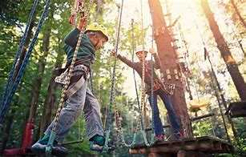

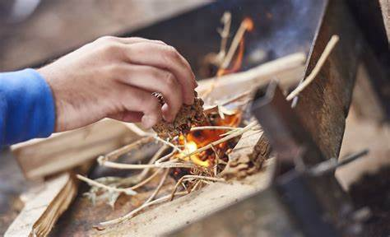

Activities
A range of activities are on offer and may include:
Mountain biking
Zip Wire
Aerial Trekking
bushcraft
campfire
Canoeing

Slide 5
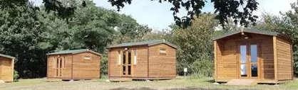
Accommodation
Glamping Pods
Our glamping-style pods can accommodate up to 8 guests per pod
You will need to bring own bedding (sleeping bag and pillow)

Slide 6
Food
Pupils need to have their own packed lunch for the day of departure (9th July)
School will prepare lunch for pupils in receipt of FSM (a slip for this will go out nearer the time)
After this, all meals and snacks are included in the price

Slide 7
Pricing
The price for the residential is £130-160(this is number dependent based on uptake (between 25 and 35 pupils)
A non-refundable deposit of £50 is required to secure the place by 12th December
The office can support with setting up a payment plan once we know final numbers and payment amount, and deposits can be made from 4pm today.

Slide 8
Other information
Pupil to adult ratio of 1:10 (in line with guidelines), including qualified first aiders
Kit lists will be provided nearer the time as this can be weather and activity dependent, however pupils will need their own sleeping bag and pillow
Detailed timings will be sent out closer to the residential once we have final confirmation from the venue
No electrical devices are permitted, including phones and ipads. This is a non-negotiable expectation due to safeguarding
Any medications need to be given to us on the day of the residential in a clear, labelled container/ bag with administration instructions. Children cannot attend without this.
Attendance is behaviour related. Unlike curriculum related school trips a part of our school offer, this is an additional offer and therefore children can be removed from attending based on behaviour.

Slide 9
What if it’s not for me?
You will be in school with familiar members of staff.
They will plan a variety of different activities for you to do at school
There’ll be no Maths and English – phew!

Slide 10
Question time!
We will take questions from the adults.
Deposits need to be paid by 12th December to secure your place

