Slide 1
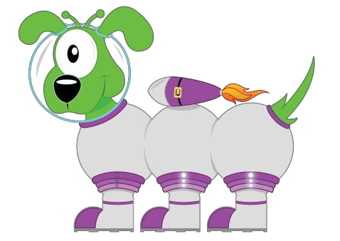
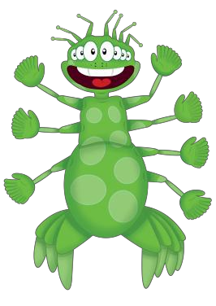
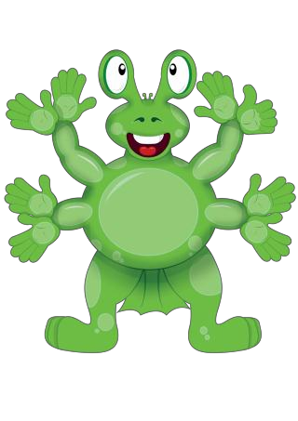
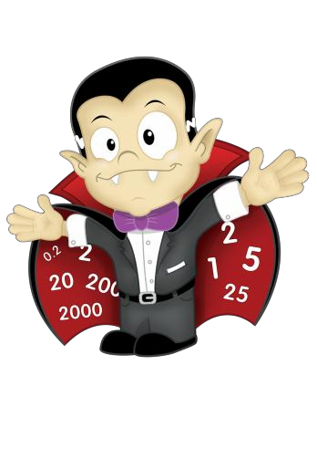
Big Maths
Parent Information

Slide 2

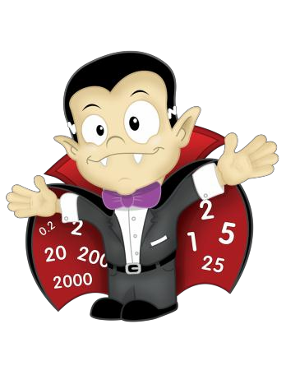
What is Big Maths?
A systematic and structured programme for ensuring that all children become properly numerate.
A whole school approach that is progressive, rigorous and fun.
Big Maths highlights how small steps of progress with
core numeracy follow on logically from one to the next.

Slide 3
Why have we chosen to do Big Maths at TPS?
Quick recall of mental maths is key to many aspects of mathematics. Without this knowledge, children can struggle especially as they move through school.
We have identified rapid recall as any area for development and feel that ‘Big Maths’ is a fun, efficient way of developing this mental recall using a daily format

Slide 4
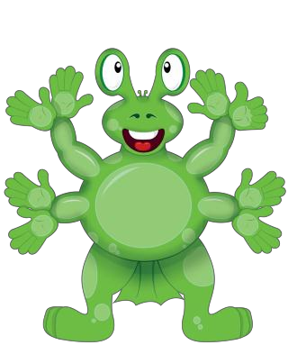
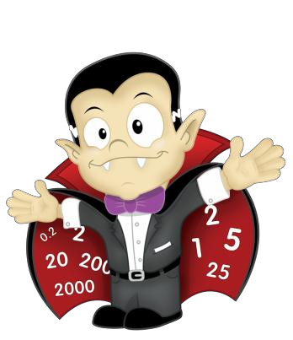
What will Big Maths look like ?
Daily practise of basic numeracy skills in simple steps
Clear progression from year to year
Common methods taught and language used
throughout the school
Build on prior learning and ensure children are secure in their knowledge
Objectives are clearly matched to National Curriculum
objectives
Improve mental maths skills and general mathematics across the school

Slide 5
CLIC
Big Maths is based upon the principle that there are 4 core skills that lie at the heart of numeracy.
These core skills form the platform for virtually all other maths skills and are affectionately known as CLIC ….Counting; Learn Its; It’s Nothing New; Calculations

Slide 6
How does CLIC work?
CLIC is fundamental to mathematical development as it is the learning sequence through which we all develop our numeracy skills.
Learn to count (C)
Learn to remember totals as facts (L)
Apply these facts to new situations through swapping the thing being
counted (I)
Apply the first three elements into a formal calculation (C)

Slide 7
A daily dose
CLIC is a sequential programme of daily basic skills for mathematics and they are revisited each lesson.
By implementing this programme we can ensure that all children have a constant, daily drive to up-level their mathematics knowledge and skills.
The frequency and focus of this programme is essential in order for children to make progress.

Slide 8

How will the daily maths lesson be organised?
Monday to Friday (CLIC Sessions) Counting – 5 minutes
Learn Its – 5 minutes
It’s Nothing New – 5 minutes Calculations – 5 minutes
This is followed by a full maths lesson where the children will get the chance to apply these skills to problems, challenges and real-life situations.

Slide 9
Counting
Children will count forwards, backwards, in a range of steps depending upon their age. They will then count by reading and then writing numbers. When practising counting at home with your children, make sure you go backwards and forwards. Don’t always start at 0 – make sure they can count on from 75 to 106 for example

Slide 10
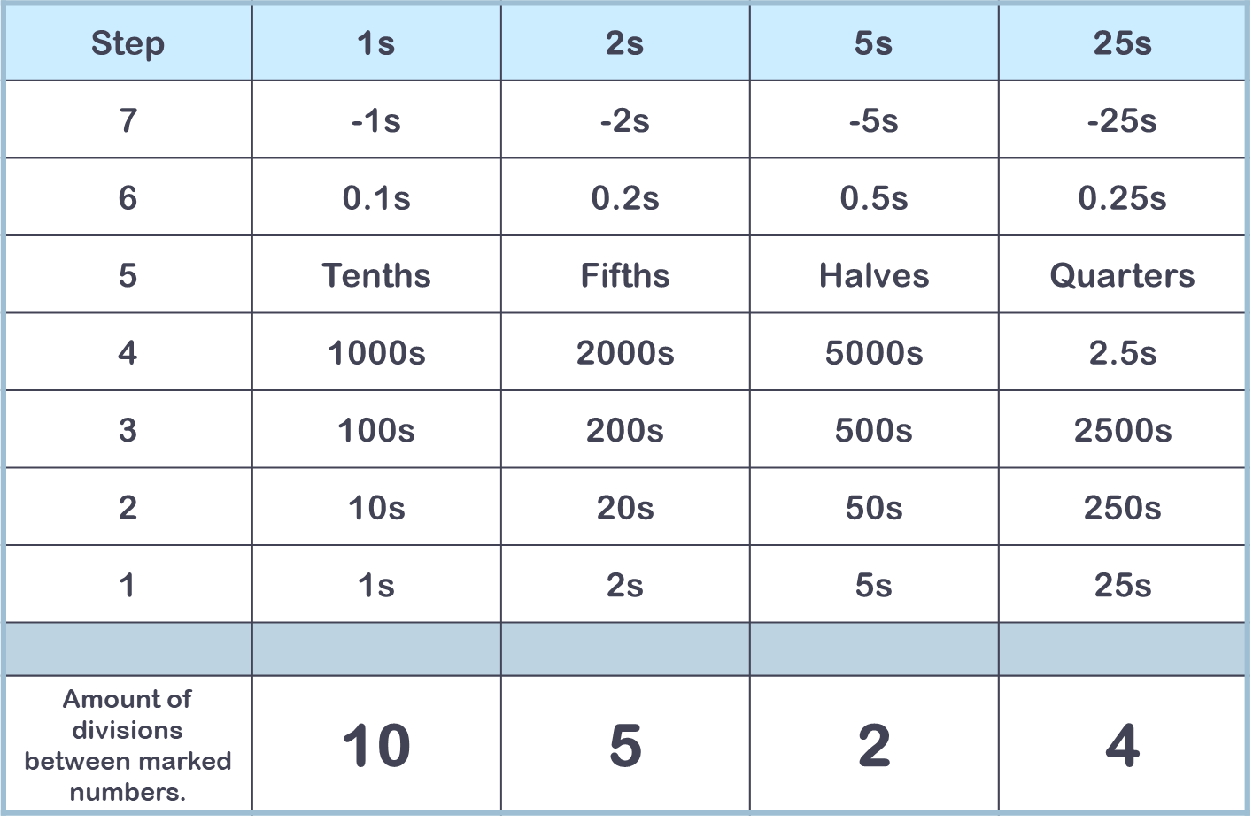
Counting Strands

Slide 11
‘Learn Its’
Learn Its are addition facts and times tables facts. There are 72 Learns Its in total. 36 addition Learn Its and 36 multiplication Learn Its. These are facts that children need to learn off by heart, so when they are asked ‘What is 6+4 ?’ they are able to give the answer as quickly as they would be able to tell you their name. As soon as they know 3x5=15 they also know 5x3=15 (This is known as a ‘Switcher’)

Slide 12
Teaching any multiplication table
Step 1 – Say multiples 1 – 5 eg 3,6,9,12,15 (this also
happens in the Counting part of CLIC)
Step 2 – Say multiples 1 – 10 (Counting)
Step 3 – Say the table – chant eg five threes are 15 – get a rhythm going – make it fun! Keep the chant the same for all tables
Step 4 – Answer Jumbled table – using information to answer tables questions all jumbled up (It’s Nothing New / Calculation)
Step 5 – Say Fact Families - linking the inverse operation
– division to multiplication.

Slide 13

‘Learn Its’ by Year Group
Reception – Doubles of 1, 2,3,4,5, and 2+1 = 3 and
2+3 = 5
Year 1 – Doubles of 6,7,8,9, and numbers which make 10 (2+8, 7+3)
Year 2- Remainder of 1 digit + 1 digit facts (eg 9+7=16) x2, x5, x10 tables facts
Year 3 – focus on x3 x4 x9 tables facts
Year 4 – the six remaining facts (6x6, 6x7, 6x8, 7x7, 7x8,8x8,) and 36 Addition Learn Its
Year 5 and 6 - all 72 Learn Its - consolidate.

Slide 14
The 36 Addition ‘Learn Its
’
+ | 2 | 3 | 4 | 5 | 6 | 7 | 8 | 9
2 | 4
3 | 5 | 6
4 | 6 | 7 | 8
5 | 7 | 8 | 9 | 10
6 | 8 | 9 | 10 | 11 | 12
7 | 9 | 10 | 11 | 12 | 13 | 14
8 | 10 | 11 | 12 | 13 | 14 | 15 | 16
9 | 11 | 12 | 13 | 14 | 15 | 16 | 17 | 18
Reception Addition ‘Learn Its’
Year One Addition ‘Learn Its’
Year Two Addition ‘Learn Its’

Slide 15
The 36 Multiplication ‘Learn Its’
X | 2 | 3 | 4 | 5 | 6 | 7 | 8 | 9
2 | 4
3 | 6 | 9
4 | 8 | 12 | 16
5 | 10 | 15 | 20 | 25
6 | 12 | 18 | 24 | 30 | 36
7 | 14 | 21 | 28 | 35 | 42 | 49
8 | 16 | 24 | 32 | 40 | 48 | 56 | 64
9 | 18 | 27 | 36 | 45 | 54 | 63 | 72 | 81
Year 2 Multiplication ‘Learn Its’
Year 3 Multiplication ‘Learn Its’
Year 4 Multiplication ‘Learn Its’

Slide 16
It’s Nothing New
‘It’s Nothing New’ is the ‘Glue’ of CLIC. For each ‘It’s
Nothing New’ step the teacher makes the learner conscious
of two currently held ideas. They will then overlap these ideas and reveal how a third ‘new’ ideas must be true.
The message that there is ‘no new maths’ is a critical part of making children conscious of the learning process and helps build their maths confidence.
The ‘It’s Nothing New’ session is typically a whole class session that uses mainly talk and Big Thought Boards (whiteboards). The teacher nudges forward with new concepts, taking the whole class with them as they go.

Slide 17
It’s Nothing New
Some of the key elements of this aspect of CLIC are:
Adding with Pim
Jigsaw Numbers
Coin Multiplication
Smile Multiplication
Count Fourways

Slide 18






Adding With Pim
There is no new maths involved when we add multiples of ten together.
30 + 40 = 70
3 tens and 4 tens
= 7 tens
So its nothing new that…
3 things and 4 things = 7 things
3 + 4 = 7

Slide 19
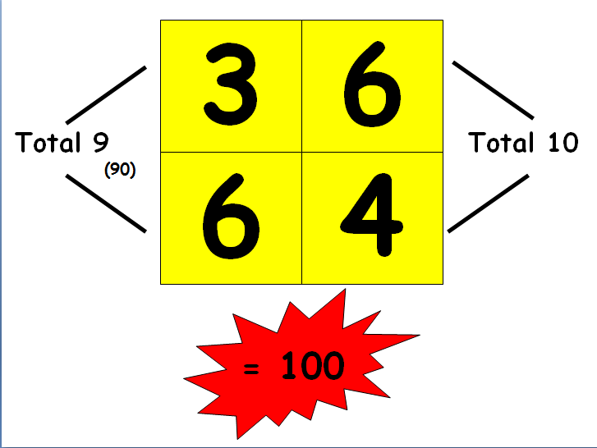

Slide 20





Jigsaw Numbers
Jigsaw numbers are just number bonds. They total a special number in our number system, e.g. 10, 100 or 1000.
Technically they are called
complements but calling them ‘jigsaw numbers’ makes them far
more accessible and
I know the missing decimal piece
I know the missing piece to 1000
memorable
for children.
I know the missing
piece to 100
I know the missing piece to the next multiple of 10
I know the missing piece to 10

Slide 21
Coin Multiplication
Coin Multiplication takes a given number (usually a 2 digit number) and multiplies it by 1, 2, 5, 10, 20, 50 and 100. If we add 200 then this covers all of the coin denominations that we use.
Children are shown how all of these multiples can be found by:
Multiplying by 10
halving and
doubling

Slide 22

Coin Multiplication
X 26
1 | 26
2 | 52
5 | 130
10 | 260
20 | 520
50 | 1300
100 | 2600
Children start by completing a 1 & 10 Coin Card
Then a 1, 2, 5, & 10 Coin Card
They then progress onto the full Coin Card

Slide 23
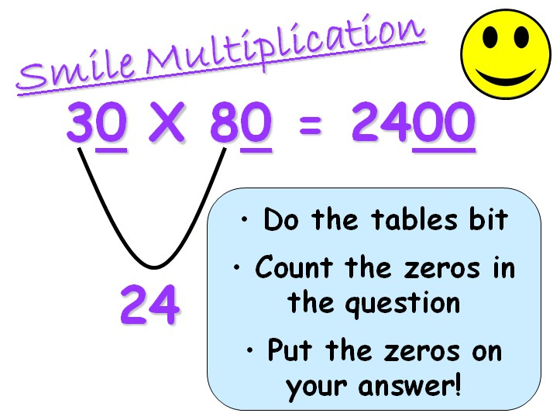

Slide 24

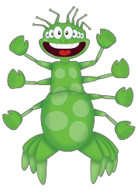




Mully
Squiggleworth _{PIM}
Big Maths Characters
Count
POM
Fourways

Slide 25
Meet Pim!
This friendly alien is PIM, the 'principle of irrelevant matter'! That means that number facts stay the same and it doesn't matter what you are counting:
3+4=7 is true if you are counting dogs, chocolates, metres, boys, girls or teachers!

Slide 26
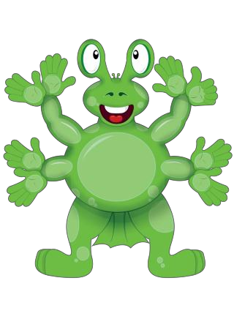
Meet Pom!
Pom is Pim's friend. He helps children learn specific maths
vocabulary so that they can talk about their maths. The space on his tummy is for multiples!
Pom helps the children to learn about factors, square numbers and prime numbers.
1 36
2
18
3
4
36
12
9
When Pom is left with only two factors the number on his tummy is a prime.
6

Slide 27
Meet Squiggleworth!
Squiggleworth, the Place Value Pet!
What is that squiggle worth?
4 | 3 | 9
400 | 30 | 9

Slide 28
Mully!
Mully helps children to put numbers in order and work with multiples.

Slide 29
Count Fourways
Use Pim principle to show children how to swap 2s for 20s, or 200s or 0.2s.
Learning to count out loud
in four particular ways
rapidly advances a child’s numeracy.
Children are also coached to count in ones and therefore 10s, 100, 0.1s etc.
The four ways are: counting in 10s, 5s, 2s and 25s.
As well as in 5s. So they can
count in 50s, 500s, 0.5s etc.
Lastly in 25s, allowing children to count in 250s, 2.5s, 0.25s etc.

Slide 30
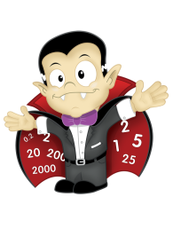
Step | 1s | 2s | 5s | 25s
7 | -1s | -2s | -5s | -25s
6 | 0.1s | 0.2s | 0.5s | 0.25s
5 | Tenths | Fifths | Halves | Quarters
4 | 1000s | 2000s | 5000s | 2.5s
3 | 100s | 200s | 500s | 2500s
2 | 10s | 20s | 50s | 250s
1 | 1s | 2s | 5s | 25s
Amount of divisions between marked numbers. | 10 | 5 | 2 | 4
The ‘Count Along in 4 Ways’ Progress Drive

Slide 31
How can I support my child?
Help your child to practice their ‘Learn Its’ at home.
Ask your child to tell you about Big Maths. What are they working on? Are they finding anything difficult.
Share your thoughts with your class teacher. We are very keen to keep Big Maths high on the agenda.
Praise! Celebrate the successes. Visit the publishers website:
http://www.andrelleducation.co.uk/courses/numeracy/big- maths/

